Slide 1
ANDROID APP ABOUT SAVEETHA BUS DETAILS
DONE BY:
Name: SHAIK AFSHAD BASHA
Register No: 191611294
GUIDED BY
A.VISHNU PRIYA
Assistant Professor(S.G.)
IT DEPARTMENT

Slide 2
INTRODUCTION
There are buses made available for students and faculty travelling distances ,but not many students and faculty have a complete information about these buses .
Complete information namely the number of buses that go to the required destination ,bus numbers ,bus timings , the routes through which the bus would pass , time taken for the bus to reach , maps that guide the passenger with his\her route and importantly , track the current location of the bus and give the current time for the bus to reach its bus stop .
The system is an android application that gives necessary information about all busses in Saveetha college .
The platform chosen for this system is android , reason being android operating system has come up on a very large scale and is owned by almost every second person.
Also, android is a user friendly platform, there by enabling ease of access for all the users .

Slide 3
ABSTRACT
The main goal of the proposed work is to improve the bus system by adding the necessary additional features into the application, like accurate bus timings , correct bus numbers and moreover adding a GPS tracker into it.
This study accepts input into in the fom of selction of the source and destination and selection of the bus travelling the distance to display the entire details abouts the routes and also track the location of the respective bus and give the map for the same.
The last two decades have seen growing intrest in the development of android based platform . Our review of this area shows that there have been only
few approaches that provide automated tools for the functioning of the application.

Slide 4
DIAGRAMATICAL REPRESENTATION
SAVEETHA COLEGE
BUS DETAILS
DRIVER NAME
BUS INCHARGE
BUS

Slide 5
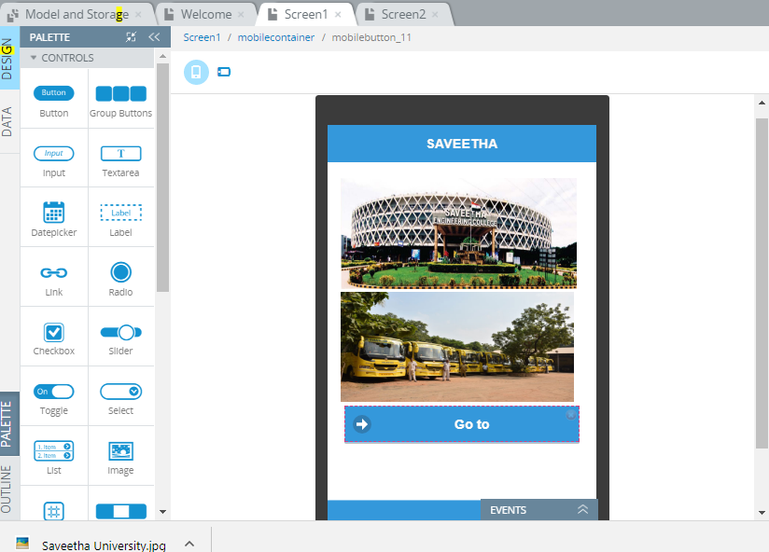
IMPLEMENTATION-SNAPSHOT

Slide 6
IMPLEMENTATION PROCEDURE
Implementation involves at the first step of the following procedure.
Inserting new pages with the required layout, texts, buttons ,labels etc..,.
Each and every constraints should have a navigation to one another.
Inserting list of items will display the details about profiles.

Slide 7
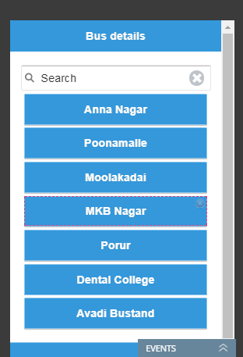
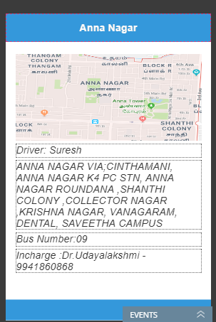
OUTPUT LAYOUT

Slide 8


